Slide 1
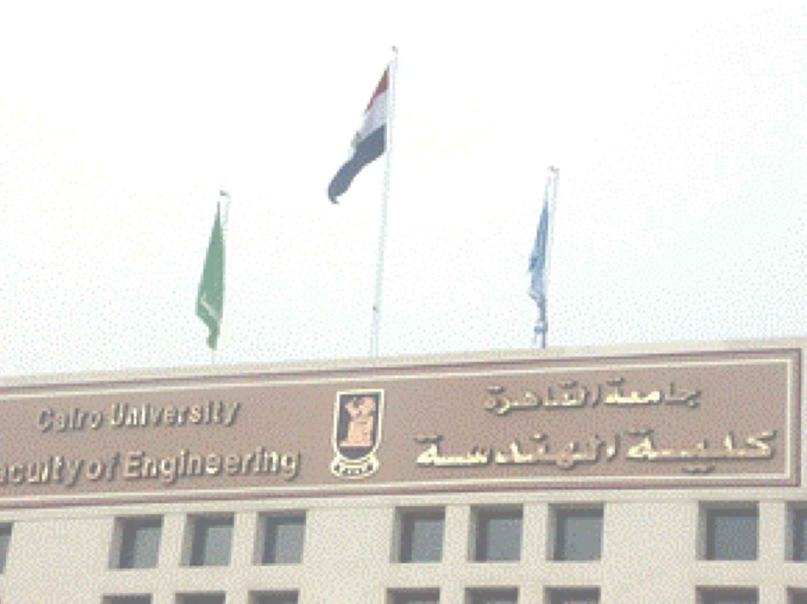
Physical Layer
  “Ad Hoc Wireless Networks: Architecture and Protocols” by C. Siva Ram Murthy and B. S. Manoj
Sections 1.2-1.6
Material partially adapted from W. ADI at Institut für Datentechnik und Kommunikationsnetze, Jean-Paul M.G. Linnartz at Eindhoven University of Technology, Mary Baker at Stanford, Raj Jain at Washington Univeristy at St. Louise, Wikipedia at http://en.wikipedia.org/,

Slide 2
Radio Spectrum: The Key Resource
Wireless devices have to work in a frequency band
Each band is associated with a bandwidth
Bandwidth ⬄ Link Capacity
Radio Spectrum licensing is strictly controlled

Slide 3
Understanding Wireless Communication
Tx
Rx
How does signal propagate ?
How much attenuation take place ?
How does signal look like at the receiver ?

Slide 4
A. The Electromagnetic Spectrum
Electromagnetic waves are characterized by
  Frequency (f) → Number of oscillations or cycles per second (Hz) (After the German scientist Heinrich Hertz)
  Wavelength (λ) → Distance between two consecutive minima or maxima in a wave (m)
Propagation speed depends on medium
In vacuum all EM waves have the speed of light c
c = λ × f
c = 3 x 10⁸ m/s

Slide 5
Frequency bands defined by International Telecommunication Union (ITU)
mostly usable for communications
Infrared
Frequency (Hz)
Ultraviolet
10⁰ | 10² | 10⁴ | 10⁶ | 10⁸
 |  |  | Radio
10⁸ | 10⁶ | 10⁴ | 10² | 10⁰
₁₀10 ₁₀12 ₁₀14 ₁₀16 ₁₀18 ₁₀20 ₁₀22 ₁₀24 ₁₀26 ₁₀28
₁₀-2
₁₀-4
₁₀-6 ₁₀-8
Visible
₁₀-10 ₁₀-12
₁₀-14
₁₀-16 ₁₀-18 ₁₀-20
Wavelength (m)
Microwave
X-ray Gamma ray
not usable:
affect health
difficult to modulate
do not propagate through obstacles
Frequency bands in the electromagnetic spectrum.

Slide 6
Basic EM Transmission Properties
Frequency determines properties of the transmission:
low frequency: pass through the obstacles;
higher frequency: more prone to absorbtion by rain or fog;
higher frequency: reflected by obstacles.
Radio waves:
  relatively easy to generate and modulate;
  have the ability to pass through the buildings;
  may travel very long distances;
  radio transmission is omni-directional.
Microwave:
  tend to travel in a straight lines;
  can be narrowly focused and concentrated in a small beam;
  cannot pass through obstacles.

Slide 7
Basic EM Transmission Properties
Infrared waves:
  cannot pass through obstacles;
  relatively directional and inexpensive to implement;
  used in short range communications.
Visible light:
  may provide very high bandwidth at a very low cost using optical laser signalling;
  hard to focus a very narrow uni-directional laser;
  cannot penetrate through rain and fog.

Slide 8
EM Spectrum
ISM* band
902 – 928 Mhz
S/W radio
FM radio
TV
2.4 – 2.4835 Ghz
AM radio
TV
cellular
5.725 – 5.785 Ghz
LF
MF
HF
VHF
UHF
SHF
EHF
f
30kHz
300kHz
3MHz
30MHz
300MHz
3GHz
30GHz
300GHz
10cm
100mm
λ
10km
1km
100m
10m
1m
1cm
X rays
f
infrared
visible
UV
Gamma rays
1 kHz
1 MHz
1 GHz
1 THz
1 PHz
1 EHz
Propagation characteristics are different in each frequency band
Notes:
ISM: Industrial, Scientific, and Medical. See next slide,…

Slide 9
Unlicensed Radio Spectrum
λ
33cm
12cm
5cm
26 Mhz
83.5 Mhz
125 Mhz
902 Mhz
2.4 Ghz
5.725 Ghz
928 Mhz
2.4835 Ghz
5.850 Ghz
cordless phones
baby monitors
WaveLan
802.11b
Bluetooth
Microwave oven
802.11a
        ISM: Industrial, Scientific, and Medical.

Slide 10
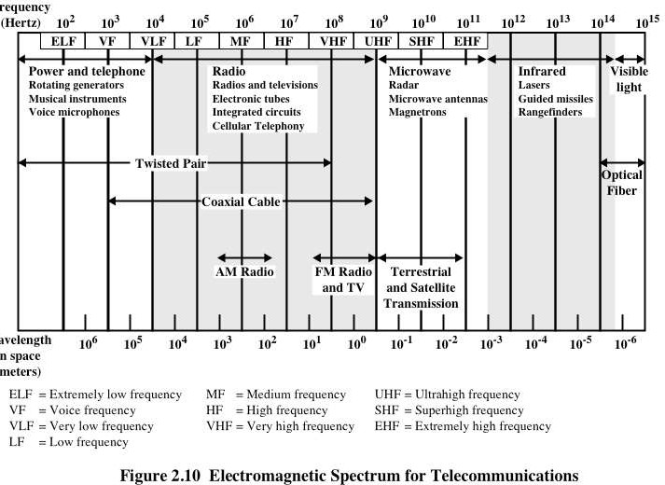

Slide 11
Evaluating Frequencies
VLF, LF, MF (Ground waves):
  follows curvature of earth.
  Few hundred Kms
  AM radio
HF, VHF (Sky waves)
  Some radio operators
  Military communication
SHF (Micro wave)
  Line of sight : Travels in straight lines
  Focused
  Distance depends on tower height ⇒ Need repeaters
  Problems with passing through buildings (needs repeaters)
  Long distance telephony → now replaced by fiber optics
  Used also Mobile phones, TV

Slide 12
Evaluating Frequencies
IR, EHF
  Millimeter waves
  Cheap short range communication
  TV, VCR, DVD… remote controls
  Directional
  Cannot travel through obstacles .. More like light.
Visible light
  Provides huge bandwidth at very low cost
  Cannot penetrate rain or thick fog
  Limited maximum distance between Tx and Rx.
  Very difficult focus a laser beam.

Slide 13
Wireless Systems: Range Comparison
1 m
10 m
100 m
1 Km
10 Km
100 Km
1,000 Km
Distance
Mobile
Telephony,
WLL
FM
Radio
MW
Radio
SW
Radio
Satellite
Links
IR
Blueooth
WLANs

Slide 14
Spectrum Allocation
Individual national governments
  AM/FM radio broadcasting
  TV broadcasting
  Mobile Telephony
    Also, coordinates which carrier uses which part of the spectrum
  Military Communication
  Government Usage
WARC
  World Administrative Radio Conference
  Agency of the ITU
  Coordinates spectrum allocation by different national governments
  ITU recommendations are not binding to governments

Slide 15
Methods of Allocating Spectrum at the National Level
Comparative Bidding (beauty contest)
  Each carrier submits a proposal to the government
  Government chooses which carrier takes the spectrum
Lottery System
  Companies with no real interest participate
  They later resell the spectrum for higher prices
Auctioning Method
  Frequency band auctioned to highest bidder
  Risky for companies.. Some may bankrupt
Some bands are unlicensed → ISM (WLANs, PANs)

Slide 16






B. Radio Waves Propagation
hills
girders
rain
hallways
windows
vehicles
trees
walls

Slide 17
Radio Propagation Mechanisms (1/4)
Radio waves experience the following propagation mechanisms:
  Reflection:
    when: wave hits an objects which is very large compared to its wavelength;
    result: phase shift of 180 degrees between the incident and the reflected rays.
  Diffraction:
    when: wave hits an object that is comparable to its wavelength;
    result: wave bends at the edges of the object, propagating in different directions.
  Scattering:
    when: wave goes through a medium with objects that are small compared to its wavelength;
    result: wave gets scattered into several weaker outgoing signals.

Slide 18
Reflection, Diffraction, and Scattering (2/4)
Reflection: Surface large relative to wavelength of signal
  May have phase shift from original
  May cancel out original or increase it
Diffraction: Edge of impenetrable body that is large relative to λ
  May receive signal even if no line of sight (LOS) to transmitter
Scattering
  Obstacle size on order of wavelength: Lamp posts etc.
If LOS (Line of Sight),
  diffracted and scattered signals not significant
  Reflected signals may be an issue
If no LOS, diffraction and scattering are primary means of reception

Slide 19
Impact of Obstacles on Radio Propagation (3/4)
Reflection
λ << D
Diffraction
λ ≈ D
Scattering
λ >> D
Low Frequencies → passes through obstacles, powers falls off rapidly
High Frequencies → absorption by rain, reflection
Propagation effects depend on not only on the specific portion of spectrum used for transmission, but also on the bandwidth (or spectral occupancy) of the signal being transmitted
Spatial separation of Tx-Rx

Slide 20

Radio Propagation (4/4)
Illustration of the radio propagation

Slide 21
C. Characteristics of the Wireless Channel
We care about these impediments because they affect
  The signal range (how long it can travel)
  The data rate (how much information it can carry)
  The reliability of wireless transmission (very important for QoS)
We will discuss
  Path loss
  Fading
  Interference
  Doppler shift

Slide 22
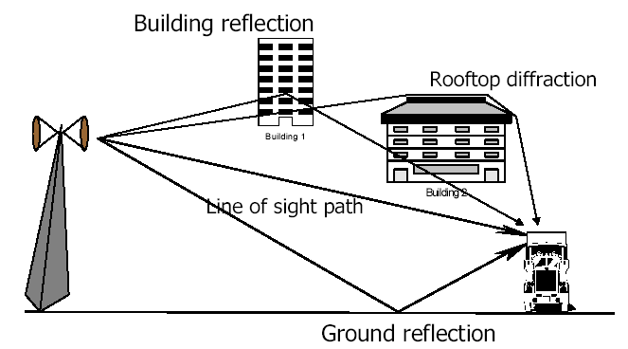
Characteristics of the Wireless Channel
Transmitter
Mobile
receiver

Slide 23
1. Path Loss
The ratio of the transmitted signal power to the received signal power on a given path.
  Function of the propagation distance
  Usually inversely proportional to the distance
Path loss depends on:
  Radio frequency
  Nature of terrain
  Type of antenna (isotropic, directive,…,etc)
Power is measured sometimes in dbm
  1 dbm = 10log₁₀(P) where P is measured in mW
  Example 1W = 1000mW = 10 log1000 = 30 dbm

Slide 24
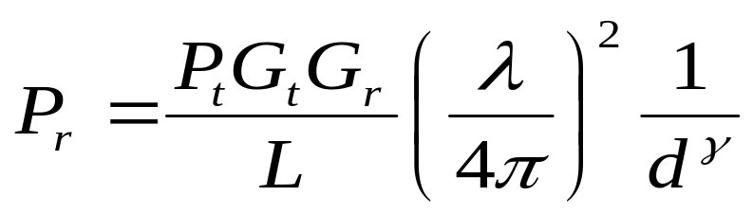
Path Loss
The free space propagation model is the simplest path loss model in which there is a direct-path signal between the transmitter and the receiver, with no atmospheric attenuation or multipath components.
In this model the relationship between the transmitted power Pt and the received power Pr is given by:
(isotropic (non-directional) antenna for LOS (Friis formula))
  P_{r}: Received power
  P_{t}: Transmitted power
  G_{t} and G_{r}: Transmitter and receiver antennas gain
  ɤ: ranges between 2 (free space) to 5 (strong attenuation)**
  λ: Wavelength = c/f, where c = 3×10⁸ m/s
  f = transmitter frequency
  L = system loss factor ( L>1 )
Path loss in dB = 10 log( P_{r}/P_{t} )
Notes:
* The formula in the book does NOT contain “L”
**You can think of it as a representative of the environment in which the wave is traveling

Slide 25
Example: Path Loss for LOS in Free Space
What is the received power(in dBm) in free space of a signal whose transmit power is 1 watt and carrier frequency is 2.4 GHz if the receiver is at a distance of 1 .6 km. (Assume antenna gains to be unity)
Solution:
ɤ is 2 because this is a free space situation
L is 1 because we assume minimal system loss
G_{t} = G_{r} = 1 (antenna gains are assumed to be unity)
Substitute in the equation in the previous slide then take 10log, the received power is given by:
10 log P_{r} = 10 log P_{t} + 20 log λ - 20 log 4π - 20 log d
Where: d is the distance between transmitter and receiver, Pr is the received power, Pt is the transmit power, λ is the wavelength of the carrier.
In this problem, the antenna gains are assumed to be unity. The transmit power is 1 W = 10 log 1000 mW = 30 dBm, the wavelength is 3 x 10⁸/2.4 x 10⁹ and d = 1600 m. Substituting in the equation, we get:
10 log P_{r} = 30 + 20 log 0.125 – 21.98 – 20 log 1600
= 30 – 18.06 – 21.98 – 64.08 = -74.12 dBm
The path loss is 30- (-74.12) = 104.12 dB.

Slide 26
2. Fading
Fading refers to the fluctuation in signal strength (phase, amplitude, polarization) when received at the receiver
Two main types
  Fast/small-scale/multipath fading
  Slow/Large-scale/shadow Fading

Slide 27
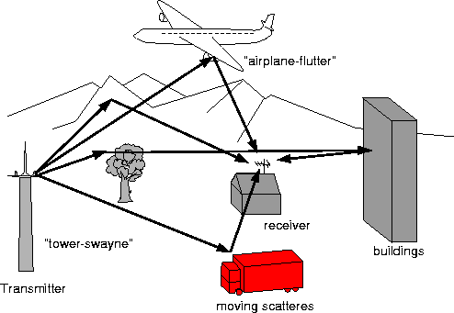
Fast/Multi-path Fading

Slide 28
Fast/Multi-path Fading
Multiple copies of the same signal received at slightly different times
Delay spread: Time between receiving the first and last copy of the same signal
Caused by reflection, diffraction, and scattering
No line of sight
  i.e. the receiver receives reflected and diffracted waves
  Envelope follows Rayleigh distribution
One line of sight path → Envelop follows Ricean distribution

Slide 29
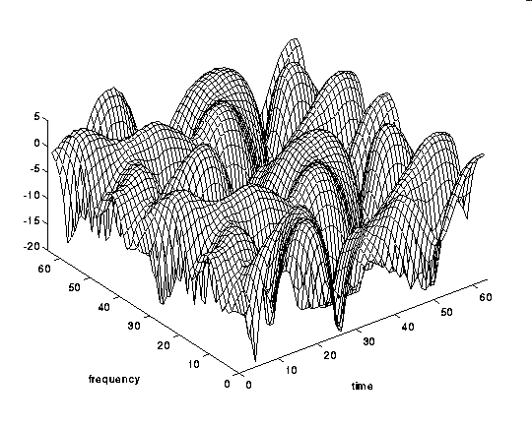
Rayleigh Multi-Path Reception
Amplitude
Time (ms)
Frequency
No LOS
  →Signal a combination of diffracted and reflected signal
The received signal amplitude depends on location and frequency
If the antenna is moving, the location x changes linearly with time t (x = v t)
Notes:
Assume the reception of a very large number of scattered waves with independent and identically distributed inphase and quadrature amplitudes.
The end result is that the received signal is a random process with

Slide 30
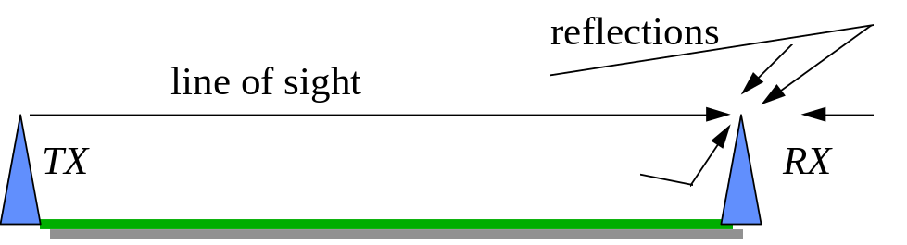
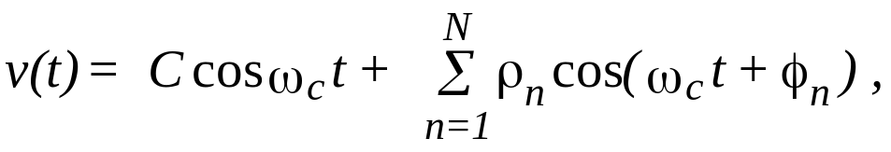
Ricean* Multi-path Reception
There is one dominant component plus one or more weaker components due to reflection mainly from ground
Again the received signal is a random process
Transmitted carrier s(t) = cos(ω_{t} t)
Received carrier
where
C is the amplitude of the line-of-sight component
ρ_{n} is the amplitude of the n-th reflected wave
φ_{n} is the phase of the n-th reflected wave
The received signal is shifted in amplitude and phase
Because we assume stationary sender and receiver, there is no shift in frequency
Notes:
* Ricean after “Rice”
Idea

Slide 31
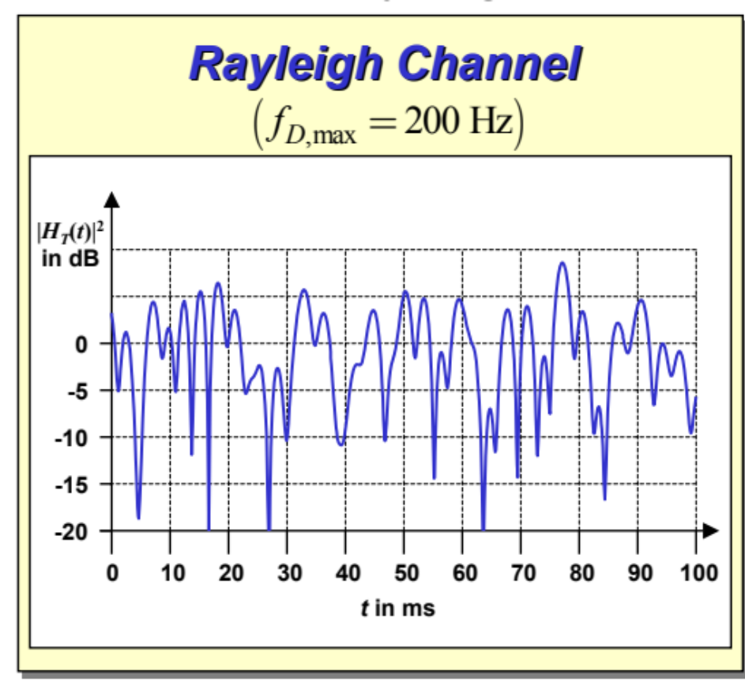
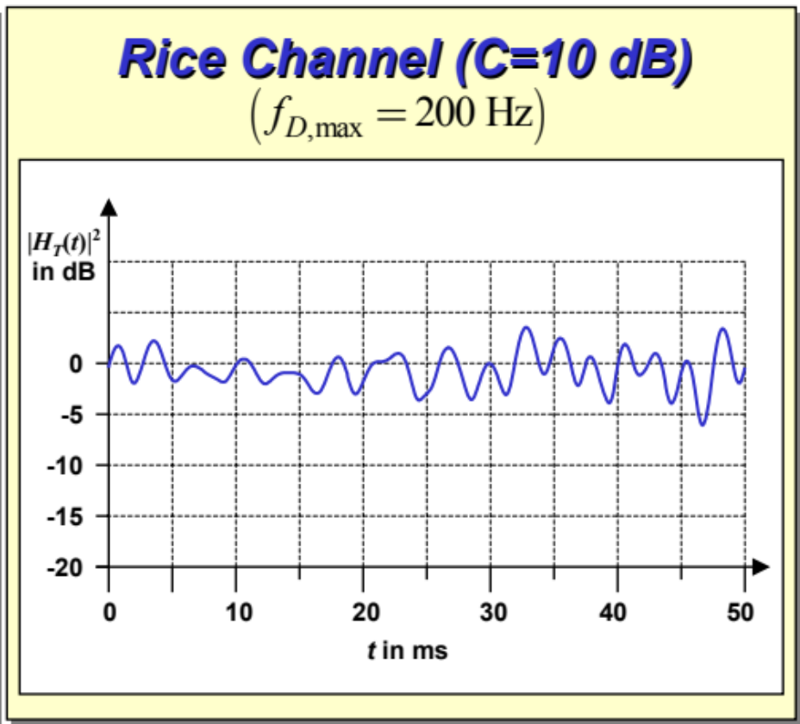
Rayleigh vs Ricean Multipath Reception
In comparison to a Rayleigh channel, the power fluctuations of a Rice channel are considerably smaller
Diagrams are courtesy of http://www.et2.tu-harburg.de/lehre/Mobile/

Slide 32
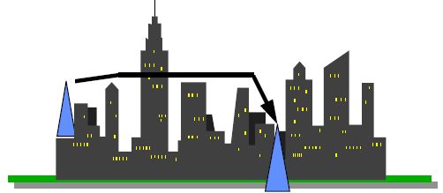
Shadow/Slow Fading
Occurs when radio signals must pass through obstacles
Slow because the duration of the fade lasts for a long time
Random reception variation even on fixed distance
Depends on the frequency, bandwidth (or spectral occupany) and the environment
Difficult to model !!

Slide 33
Typical Attenuation
In general, 900MHz suffers less attenuation
900 MHz
  20 cm concrete 7 dB
  wood and brick siding 3 dB
  Aluminum siding 2 dB
  metal walls 12 dB
  office furnishing 1 dB
2.4 GHz
  Plasterboard wall 3 dB
  Glass wall with metal frame 6 dB
  Cinder block wall 4 dB
  Office window 3 dB
  Metal door 6 dB
  Metal door in brick wall 12 dB

Slide 34
Countering Fading
Ideas:
  Diversification
  Adaptive modulation
Diversification (Time, Frequency, Space)
  Send same signals using multiple way, Different ways experience different fading
  Example of frequency diversification
    DSSS, FHSS
  Example of space diversification
    Antenna array
Adaptive modulation
  Channel Characteristics estimated
  Feed back to transmitter for adapting the modulation of the signal
  Difficult and complex

Slide 35
3. Interference
Interference means two or more signals affecting each other.
In some times it is referred to as cross talk
Three main types of interference
  Adjacent Channel Interference
  Co-channel Interference
  Inter Symbol Interference

Slide 36
Adjacent Channel Interference
Signals in nearby frequencies have components outside their allocated ranges
Introduce guard bands between allocated frequency ranges
Use adequate filtering

Slide 37
Co-channel Interference
Due to other nearby systems using the same transmission frequency
Counter it by use of
  Multiuser detection mechanisms (Used in CDMA)
  Directional antenna
  Dynamic channel allocation methods

Slide 38
Inter Symbol Interference
Temporal spreading and consequent overlapping of individual pulses in the signal.
Is a form of distortion of a signal in which one symbol interferes with subsequent symbols
Usually caused by multi-path propagation and the inherent non-linear frequency response of a channel (different frequencies travel at different speeds, attenuation,…, etc).
Adaptive Equalization
  Estimate the channel response (training using well known periodic pulses)
  Compensate for the time dispersion

Slide 39
4. Doppler Shift
The change/shift in the frequency of the received signal when the transmitter and the receiver are mobile with respect to each other.
If they are moving towards each other, then the frequency will be higher
If they are moving away from each other, then the frequency will be lower
f_{d} = v/ λ
  v : relative velocity between Tx and Rx
  f_{d}: The change in frequency
The shift depends on the frequency
  → Distortion varies by signal bandwidth

Slide 40
D. Transmission Rate Constraint
Governed by
  Channel bandwidth
  Signal to Noise Ratio (SNR)
Nyquist Rate
  Provides theoretical upper bound on the rate of information transmission given a noise-free channel
  Do not confuse with Nyquist sampling rate
Shannon’s theorem
  Provides an upper bound on the transmission rate given a noisy channel

Slide 41
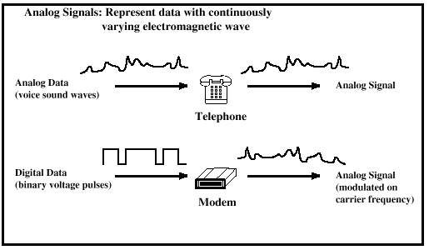
Analog signaling

Slide 42
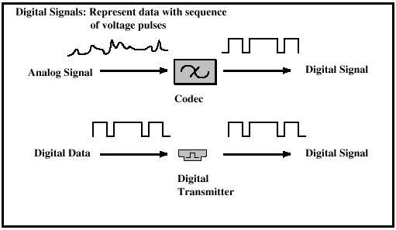
Digital signaling

Slide 43
Analog/Digital Signals
 | Analog Signal | Digital Signal
Analog Data | Two alternatives: (l) signal occupies the same spectrum as the analog data; (2) analog data are encoded to occupy a different portion of spectrum. | Analog Data are encoded to produce digital bit stream
Digital Data | Digital data are encoded using a modem to produce analog signal. | Two alternatives: signal consists of two voltage levels to represent the two binary values; digital data are encoded to produce a digital signal with desired properties.

Slide 44
Signal Transmission
Analog Transmission Digital Transmission Analog Signal Digital Signal Is propagated through amplifiers; same treatment whethersignal is used to represent analog data or digital data. Not used Assumes that the analog signal represents digital data. Signal is propagatedthrough repeaters; ateach.repeater, digital data are recovered from inbound signal andused to generate a new analog outbound signal. Digital signal represents a stream of Is and Os, which may represent digital data or may be an encoding of analog data. Signal is propagated through repeaters; at each repeater, stream of Is and Os is recovered from inbound signal and used to generate a new digital outbound signal.
 | Analog Transmission | Digital Transmission
Analog Signal | Is propagated through amplifiers; same treatment whether signal is used to represent analog data or digital data. | Assumes that the analog signal represents digital data. Signal is propagated through repeaters; at each repeater, digital data are recovered from inbound signal and used to generate a new analog outbound signal.
Digital Signal | Not used | Digital signal represents a stream of 1s and 0s, which may represent digital data or may be an encoding of analog data. Signal is propagated through repeaters; at each repeater, stream of 1s and 0s is recovered from inbound signal and used to generate a new digital outbound signal.

Slide 45
Channel Capacity
There are four concepts here that we are trying to relate to one another:
  Data rate: This is the rate, in bits per second (bps), at which data can be communicated.
  Bandwidth: This is the bandwidth of the transmitted signal as constrained by the transmitter and the nature of the transmission medium, expressed in cycles per second, or Hertz.
  Noise: the average level of noise over the communications path.
  Error rate: This is the rate at which errors occur, where an error is the reception of a 1 when a 0 was transmitted or the reception of a 0 when a 1 was transmitted.

Slide 46
Nyquist Theorem
(Noise-Free Channel)
Signaling speed:
  The number of times per second the signal changes its value/voltage
  Also known as symbol rate and Measured in baud
  For example, if the signal has 4 voltage levels 0,1,2,3,
    each level can carry 2 bits 00, 01, 10, 11
    if the signal changes its value 4 times per second
      Its baud rate is 4 → Its bit rate is 8
Nyquist rate
  C (bit rate) = 2B log₂ L bits/sec
  B = channel bandwidth in Hz
  L = Number of discrete signal/voltage levels
Given a bandwidth of B, the highest signal rate that can be carried is 2B. This limitation is due to the effect of inter-symbol interference, such as is produced by delay distortion.

Slide 47
Nyquist Theorem
In the above example, L=4, therefore C = 2(log₂4)xbandwidth
In theory, we can transmit infinite amount of information if we can divide the signal info infinite number of levels
What prevents us from having infinite levels?
If the data rate is increased, then the bits become "shorter" in time, so that more bits are affected by a given pattern of noise. Thus, at a given noise level, the higher the data rate, the higher the error rate.
Limiting factor: noise → Shannon’s theorem

Slide 48
Shannon Theorem
Signal to noise ratio SNR measured in decibel (dB)
  It is ratio of Signal Power (S) to Noise power (N)
  SNR_{db} = 10 log₁₀ Signal Power
  Noise Power
Maximum channel capacity C in bits/sec
C= B log₂ (1+SNR)

Slide 49
Example
If Phone wire bandwidth = 3100 Hz and SNR is 30db, calculate the max. channel capacity and the maximum number of signaling levels
  30 dB = 10 Log₁₀ SNR
  3 = Log₁₀ SNR
  SNR = 10³ = 1000
  Capacity = 3100 log₂(1+1000) = 30,894 bps
  Based on Nyquist:
  C=2B log₂ L
  30894 = 2 *3100 * log₂ L
  log₂ L = 4.98
  L = 31.5 = 31 levels

Slide 50
E. Modulation Techniques
How to convert Data (digital or analog) into an Electromagnetic wave???
Modulation alters certain properties of a radio wave, called carrier wave, whose frequency is the same as the frequency of the wireless channel used for transmission.
Allocated radio spectrum is a precious resource (lots of money may have been used to purchase it) so it better be used efficiently.
Types:
  Analog Modulation (for analog signals)
  Digital Modulation (for digital signals)

Slide 51
Modulation Techniques
Analog Modulation
  Transmits continuous signals
  Amplitude Modulation (AM)
  Frequency Modulation (FM)
  Phase Modulation (PM)
Digital Modulation: Transforming digital data into analog signals
  Used to transmit digital signals that consist of a sequence of 0 and 1 bits.
  Occur at discrete time intervals
  Amplitude Shift Keying (ASK)
  Frequency Shift Keying (FSK)
  Phase Shift Keying (PSK)
  FSK and PSK are sometimes called angle modulation

Slide 52
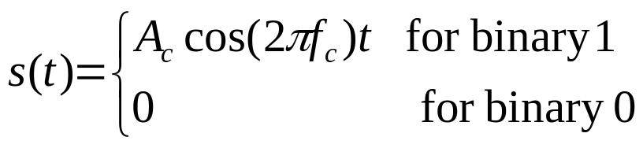
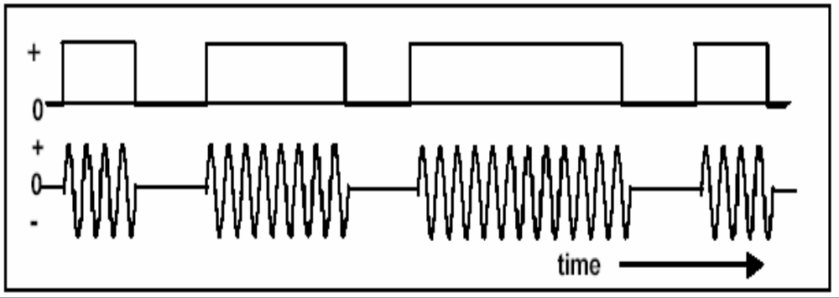
Amplitude Shift Keying (ASK)
Sometimes called On-Off Keying (OOK)
A binary 1 is represented by the presence of the signal for a specified period of time.
A binary 0 is represented by the absence of the signal.

Slide 53
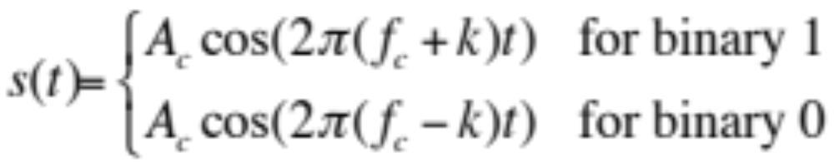
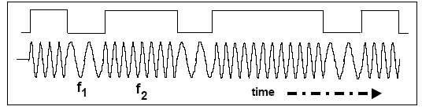
Frequency Shift Keying (FSK)
Different frequencies represent different symbols
BFSK → Binary FSK (only two frequencies used to represent single bits)

Slide 54
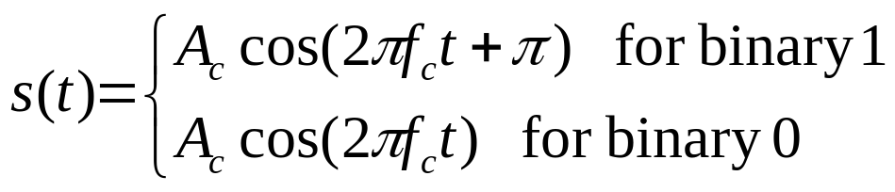
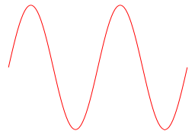
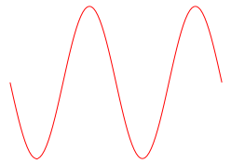
Phase Shift Keying (PSK)
Different phases for different symbols
BPSK → Binary PSK (only two phases used to represent single bits)
1
1
0
1
0
T

Slide 55
F. Multiple Access Techniques
Transmission Medium in wireless networks is broadcast in nature → thus a node can’t just transmit whenever it wants to.
Multiple access techniques are used to control access to the Shared Medium
Examples:
  Frequency Division Multiple Access (FDMA)
  Time Division Multiple Access (TDMA)
  Code Division Multiple Access (CDMA)
  Space Division Multiple Access (SDMA)

Slide 56
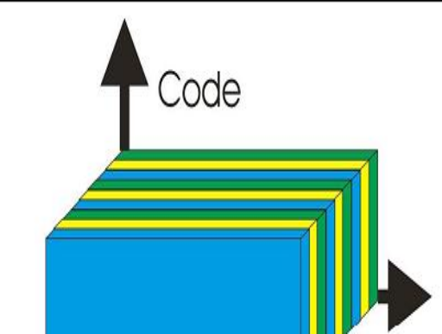
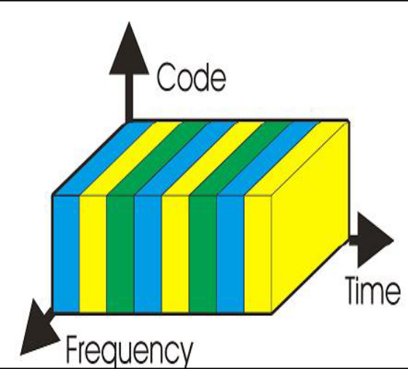
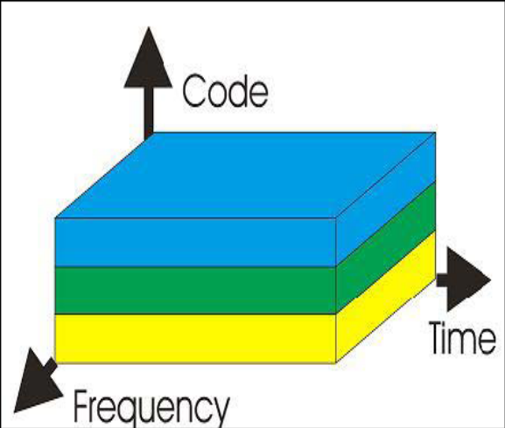
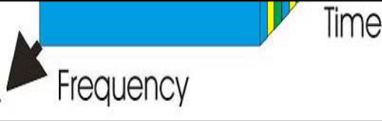
Multiple Access techniqes
FDMA vs TDMA vs CDMA
SDMA is different

Slide 57
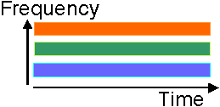
FDMA
BW is divided into multiple frequency channels/bands separated by guard bands (to eliminate inter-channel interference) → tradeoff (efficiency versus interference)
A Tx/Rx uses a single dedicated frequency channel
Example,
  Cellular networks → the base station (BS) dynamically allocates a different carrier frequency to each mobile station (MS)
  Each node is allocated two frequencies (UpLink UL and DownLink DL)
    Called FDD (Frequency Division Duplex)
  Higher frequency suffers more attenuation → more power for higher frequency
  UL frequency is normally lower than DL frequency to preserve power at the MS
Notes:
since high frequency transmissions suffer greater attenuation when compared to low frequency transmissions, high transmission power is required for high frequency channels for compensating the transmission losses. Power available at an MS is limited. Hence, in order to conserve energy at the MS, the uplink frequency is always lower than the downlink frequency.

Slide 58
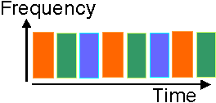
Synchronous TDMA
Each channel uses the entire bandwidth for a certain period of time
The transmit bandwidth is N times the bandwidth that would be needed to accommodate a single user. (fixed slot)
  Receiver can be built with broader filters, less expensive and smaller than FDMA.
  Hence Used in 2G networks such as GSM
Generally slotted periods called frames
A Tx/Rx is assigned one or more time slot in each frame. The node transmits only on those slots.
For two-way communication,
  UL and DL time slots are allocated
  Can be on the same band time division duplex-TDMA (TDD-TDMA)
  Can be on different bands Frequency division duplex-TDMA (FDD-TDMA)

Slide 59
Code Division Multiple Access (CDMA)
Every channel uses the entire spectrum, hence the name Spread Spectrum
Each channel transmission is encoded with pseudo-random digital sequence.
A unique code is assigned to each user.
Codes are orthogonal: The orthogonality of the codes enables simultaneous data transmissions from multiple users using the entire frequency spectrum.
Types:
  Frequency Hopping Spread Spectrum (FHSS)
  Direct Sequence Spread Spectrum (DSSS)

Slide 60
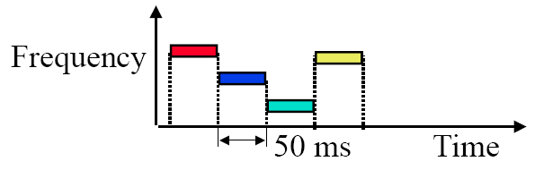
Frequency Hopping Spread Spectrum (FHSS)
the signal is broadcast over a seemingly random series of radio frequencies, hopping from frequency to frequency at fixed intervals.
The transmission switches (hops) across multiple narrow-band frequencies in a pseudo-random manner
Developed initially for military
Narrowband interference can’t jam

Slide 61
Frequency Hopping Spread Spectrum (FHSS)
Frequency Hopping: is the process of switching from one channel to the other.
De-hopping is performed at the Rx using a frequency synthesizer based on the pseudo-random sequence generator.
The sequence of transmission frequencies is known to Tx-Rx pair → appears random to other nodes.
Dwell time: time spent in a particular frequency
Slow-FHSS: Large dwell time → multiple bits per frequency
Fast-FHSS: dwell time very small compared to bit rate → bit occupies multiple frequency

Slide 62
Direct Sequence Spread Spectrum (DSSS)
Each node in the network assigned an n-bit code, called chipping-code.
n is the chipping-rate.
All codes are orthogonal to each other, i.e. the normalized inner product of the vector representations of any two codes is zero.
Example of orthogonal codes v₁=(1,-1) and v₂=(1,1)
For a binary 1, the sender transmits its code
  If the user is using v₁, then it would transmit the code v₁=(1,-1)
For a binary 0, the sender transmits the complement of the code.
  If the user is using v₁, then it would transmit the code -v₁=(-1,1)
Hence the transmission of a signal using DSSS occupies n times the bandwidth required for narrow band transmission
  Hence transmission is spread over large BW → DSSS is resistant to multi-path interference
Used in all CDMA cell telephony systems

Slide 63
Orthogonal Code Example Encoding
Assume we have two users that use orthogonal codes v₁=(1,-1) and v₂=(1,1)
User 1 wants to transmit (1,0,1,1)
User 2 wants to transmit (0,0,1,1)
Encoding of user1 = [(1,–1),(–1,1),(1,–1),(1,–1)]
  Resulting signal is [1,–1,–1,1,1,–1,1,–1]
Encoding of user2 = [(–1,–1),(–1,–1),(1,1),(1,1)]
  Resulting signal is [–1,–1,–1,–1,1,1,1,1 ]
Composite transmitted signal is
  (1,–1,–1,1,1,–1,1,–1) + (–1,–1,–1,–1,1,1,1,1) = (0,–2,–2,0,2,0,2,0)

Slide 64
Orthogonal Code Example Decoding
Received Composite signal
  C = (0,–2,–2,0,2,0,2,0)
We know that the chipping rate is 2, hence
  C = [(0,–2),(–2,0),(2,0),(2,0)]
To decode
  User1 = C.v₁
  User2 = C.v₂
User 1 = [(0,–2),(–2,0),(2,0),(2,0)].(1,-1)
    = ((0+2),(–2+0),(2+0),(2+0))
    = (2,-2,2,2)
User 2 = [(0,–2),(–2,0),(2,0),(2,0)].(1,1)
= (0–2),(–2+0),(2+0),(2+0))
= (-2,-2,2,2)
Above zero → 1
Below Zero → 0
Hence the received bits are…
  User 1 = (1,0,1,1)
  User 2 = (0,0,1,1)

Slide 65
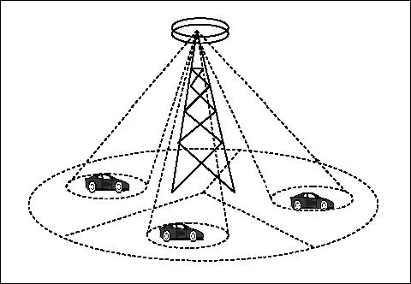
Space Division Multiple Access (SDMA)
Space dimension
Uses directional tx antennas to cover angular regions.
Same frequency is used for each space
Example,
  Satellite systems
  Focused beam
  The Satellite reuses
  the same frequency to
  cover many regions on
  Earth’s surface

Slide 66
